Slide 1

Dynamics of mapping and stable regimes of singulary pertubed neuron system
Postgraduate student,
Faculty of computer science,
Ivanovsky Leonid

Slide 2
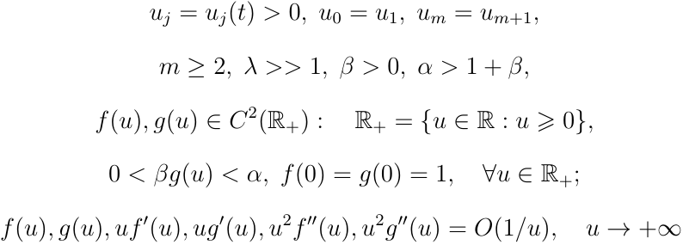
Dynamic system

Slide 3
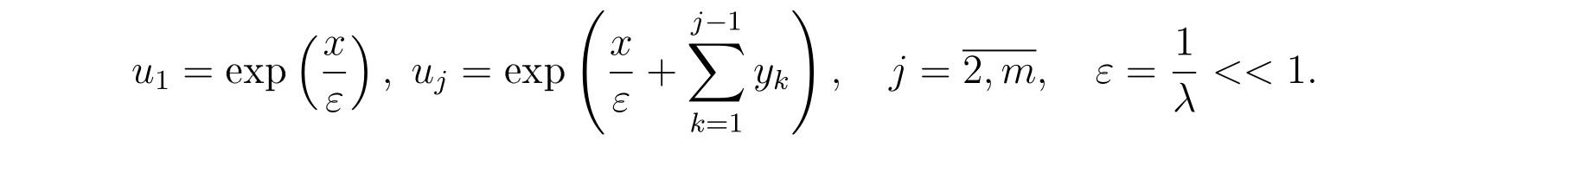
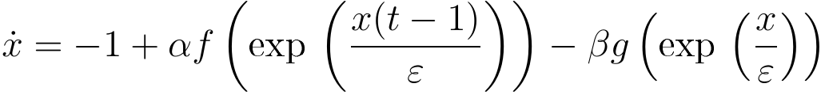
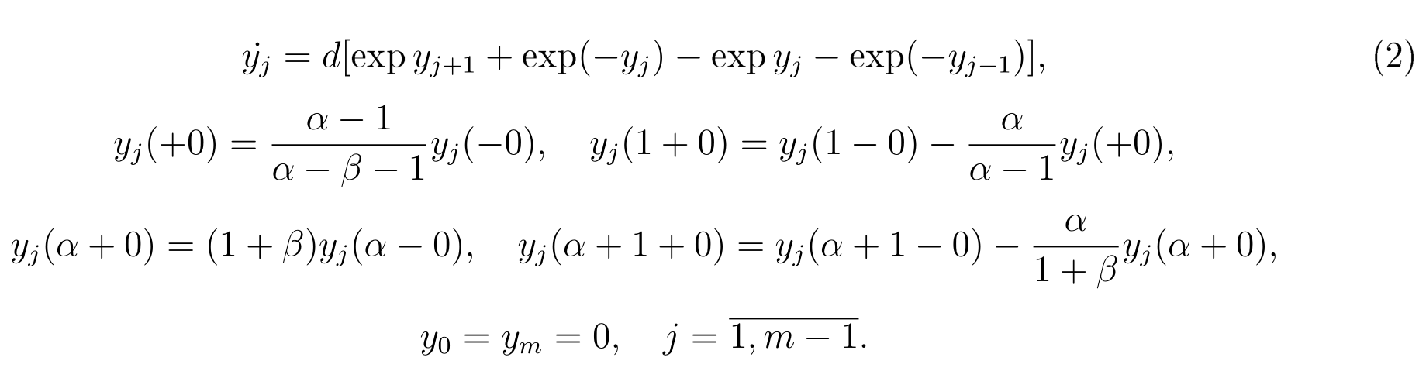
Dynamic system

Slide 4

Mapping

Slide 5




Method of research

Slide 6
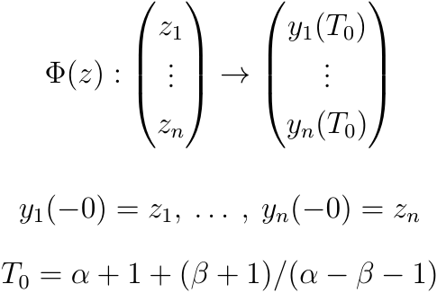

Slide 7
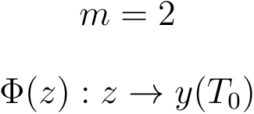
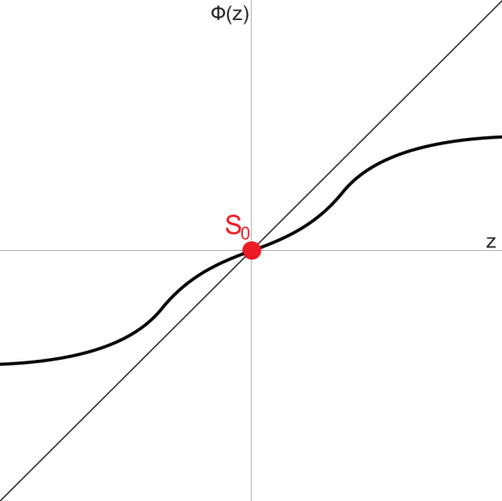
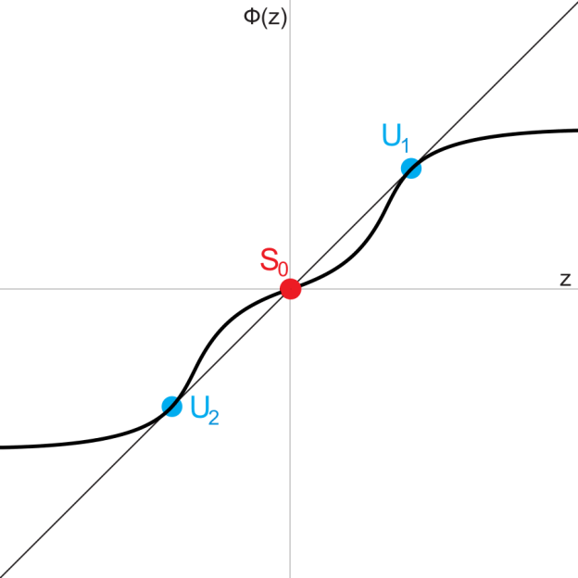
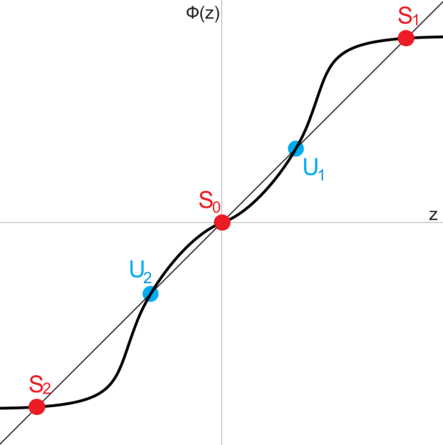

Results of research: one-dimensional case
d=0.05
d=0.0435
d=0.03

Slide 8
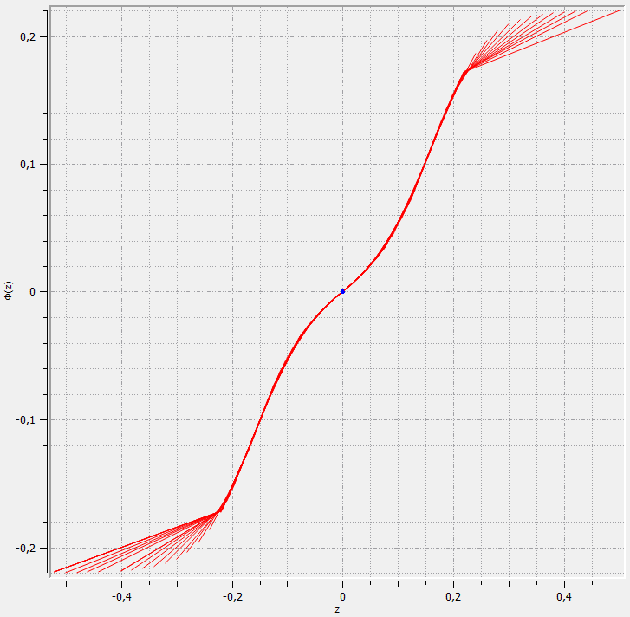
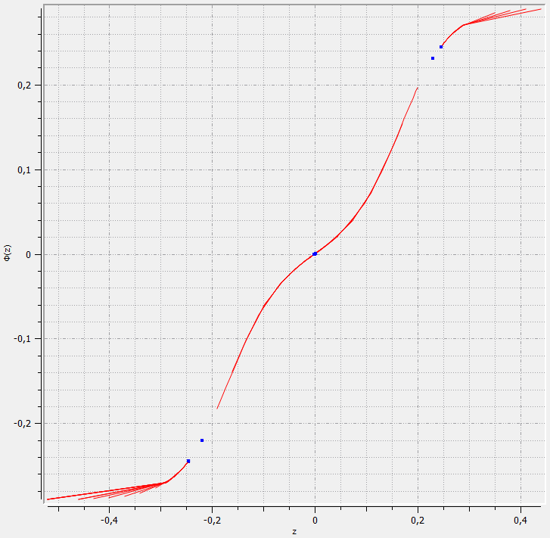
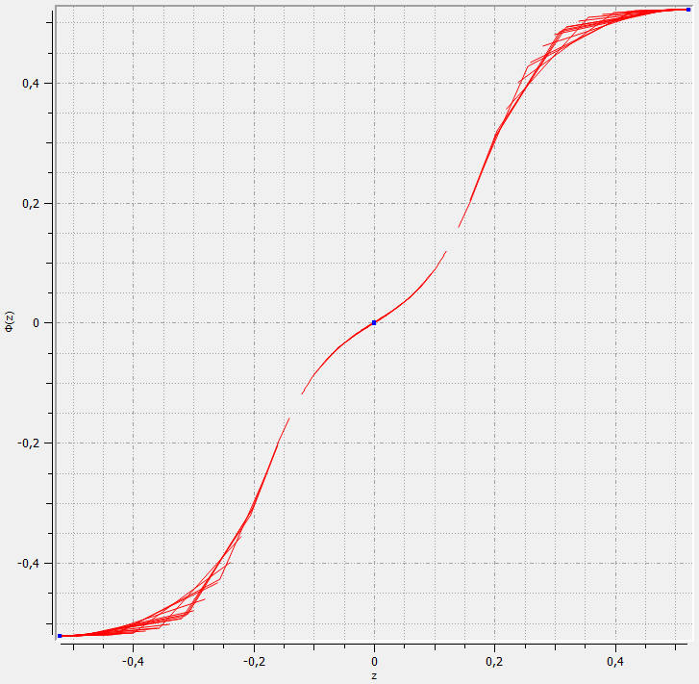
Screenshots of program for one-dimensional-case
d=0.05
d=0.0435
d=0.03

Slide 9
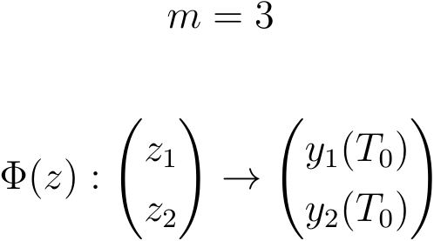
Results of research: two-dimensional case

Slide 10
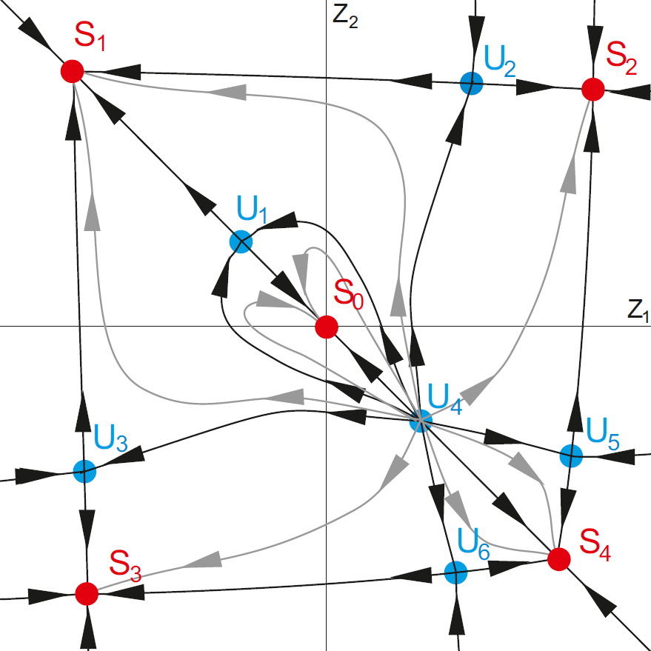
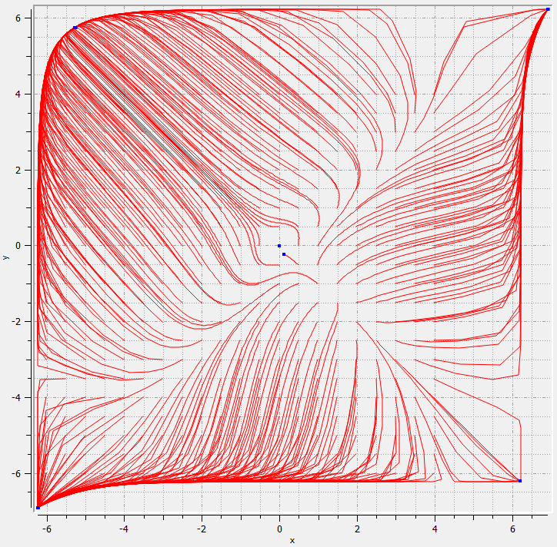
Two-dimensional case: 5 stable points

Slide 11
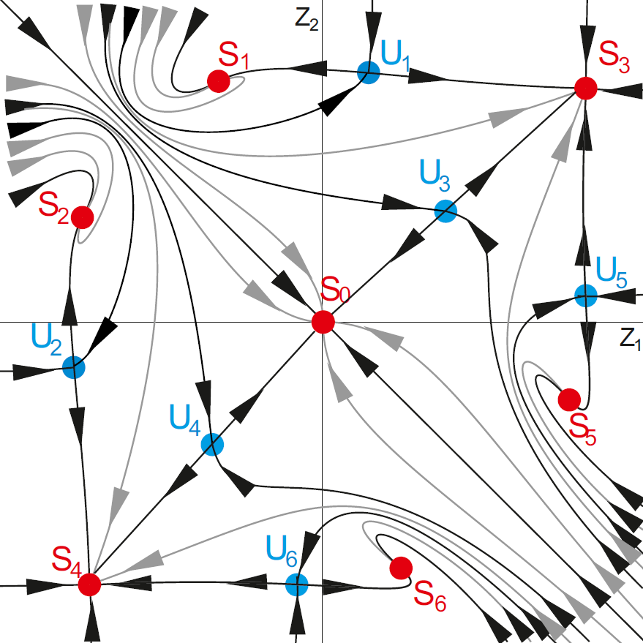
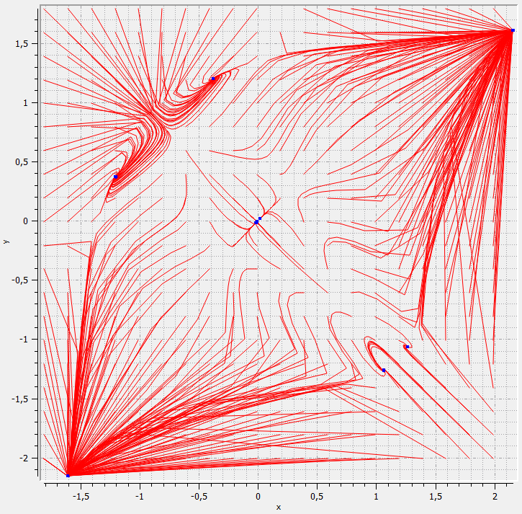
Two-dimensional case: 7 stable points

Slide 12
Thanks for your attention!

